Slide 1
Efficient VR and AR Navigation through Multiperspective Occlusion Management
Paper Session: 15
Meng-Lin Wu and Voicu Popescu
Purdue University
IEEE TVCG Invited Paper

Slide 2
Motivation
Tracked Head-Mounted Displays (HMD)
A natural interface for exploring 3D scenes in AR and VR

Slide 3
Motivation
Tracked Head-Mounted Displays (HMD)
A natural interface for exploring 3D scenes in AR and VR
Can be inefficient due to occlusions
?
user

Slide 4
Motivation
Tracked Head-Mounted Displays (HMD)
A natural interface for exploring 3D scenes in AR and VR
Can be inefficient due to occlusions
Translation required to reduce occlusion
user
nothing

Slide 5
Motivation
Tracked Head-Mounted Displays (HMD)
A natural interface for exploring 3D scenes in AR and VR
Can be inefficient due to occlusions
Sequential exploration is slow
nothing
user

Slide 6
Motivation
Tracked Head-Mounted Displays (HMD)
A natural interface for exploring 3D scenes in AR and VR
Can be inefficient due to occlusions
Parallel visualization is difficult
user

Slide 7
How to address occlusions?
Multiperspective visualization
user

Slide 8
How to address occlusions?
Multiperspective visualization
B
A
user
user
Primary viewpoint A, secondary viewpoint B

Slide 9
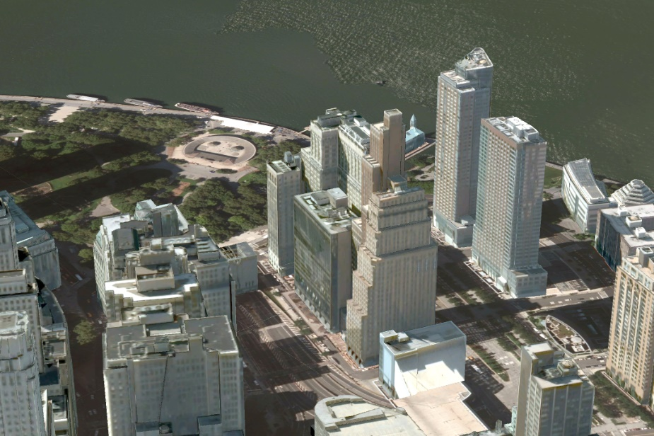
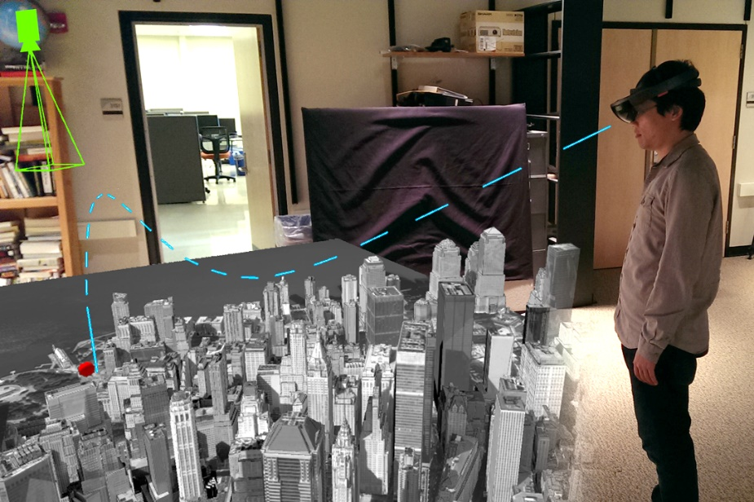
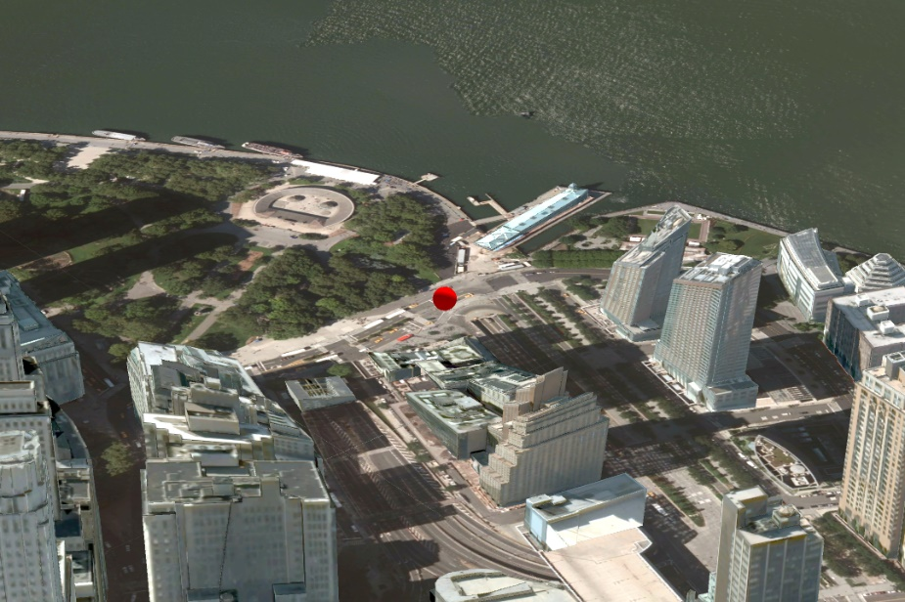
MPV for urban scenes, shown in VR
Main perspective
MPV construction
to reveal street-level target
Main + secondary perspective

Slide 10
MPV for urban scenes
Main perspective
Main perspective +
2 secondary perspectives

Slide 11
MPV for indoor scenes, shown in AR
User wearing AR HMD
Main perspective from user
Secondary perspective showing side corridor
AR annotation rendered with pre-acquired real world model + dynamic virtual target

Slide 12
User study
16 subjects
Two VR and two AR tasks
VR urban
AR corridor

Slide 13
User study
Metrics
Total distance traveled
Total head rotation
Completion time

Slide 14
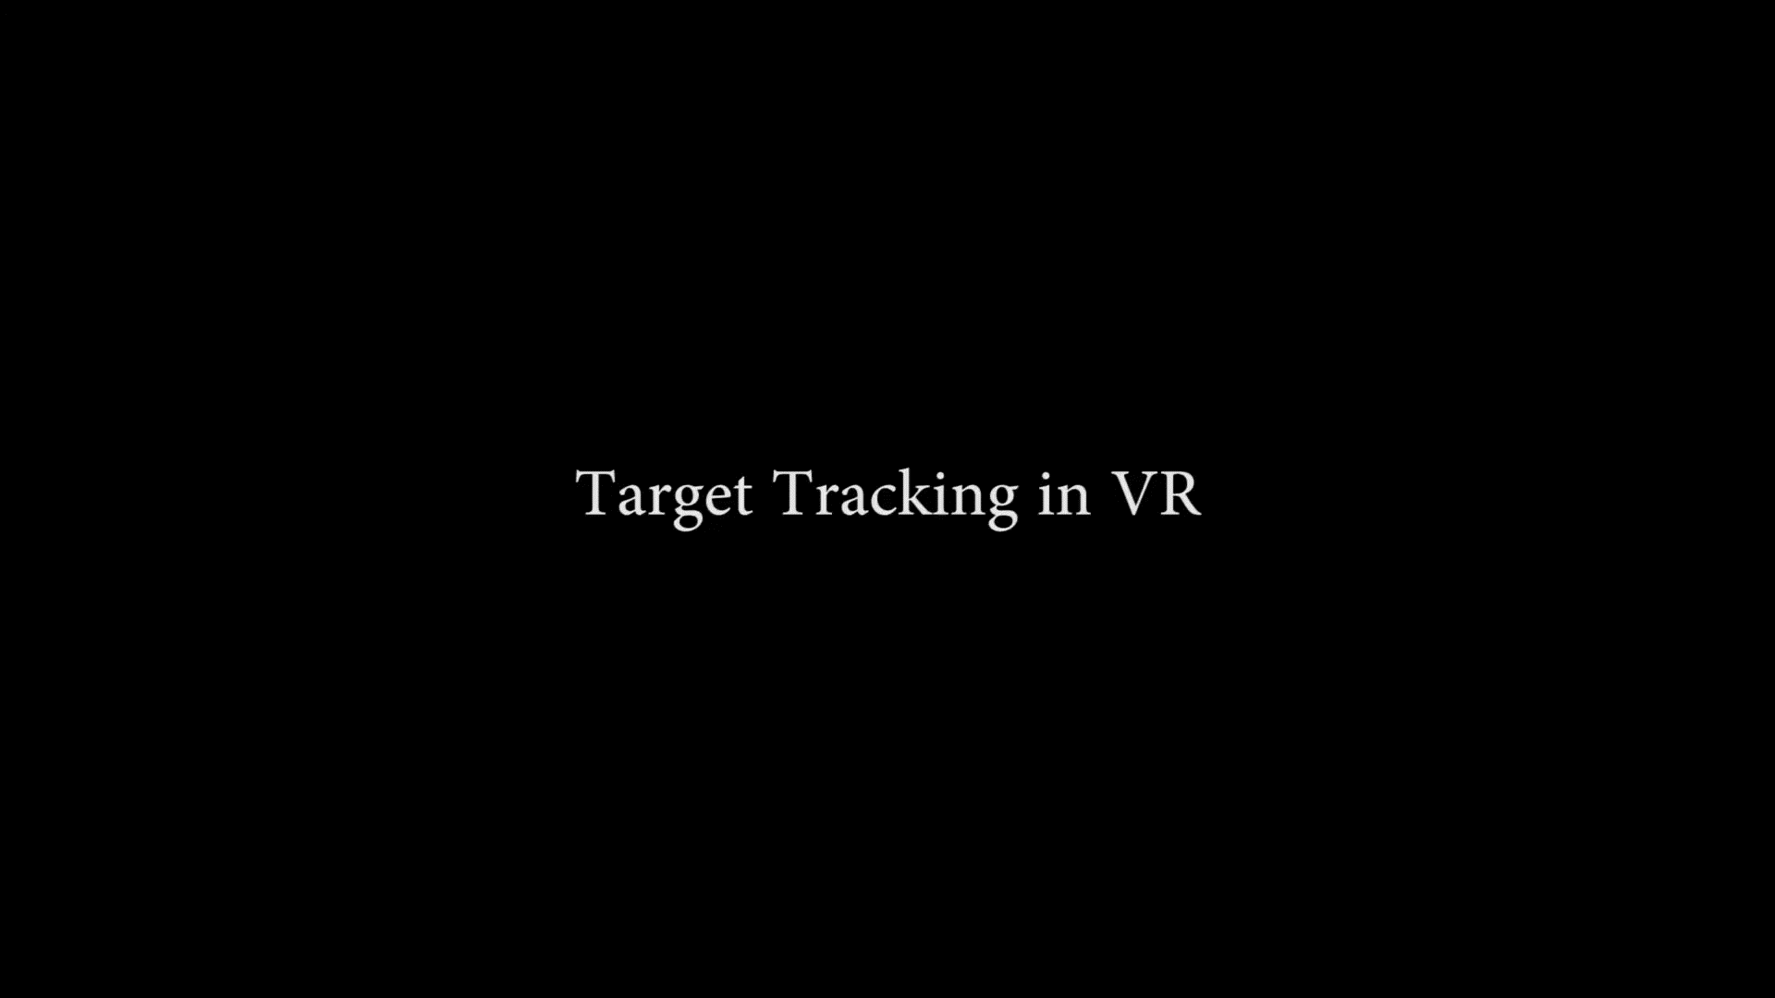
User study
VR task 1: keep moving target in view

Slide 15
Sample user trajectory for VR tracking
Conventional
MPV

Slide 16
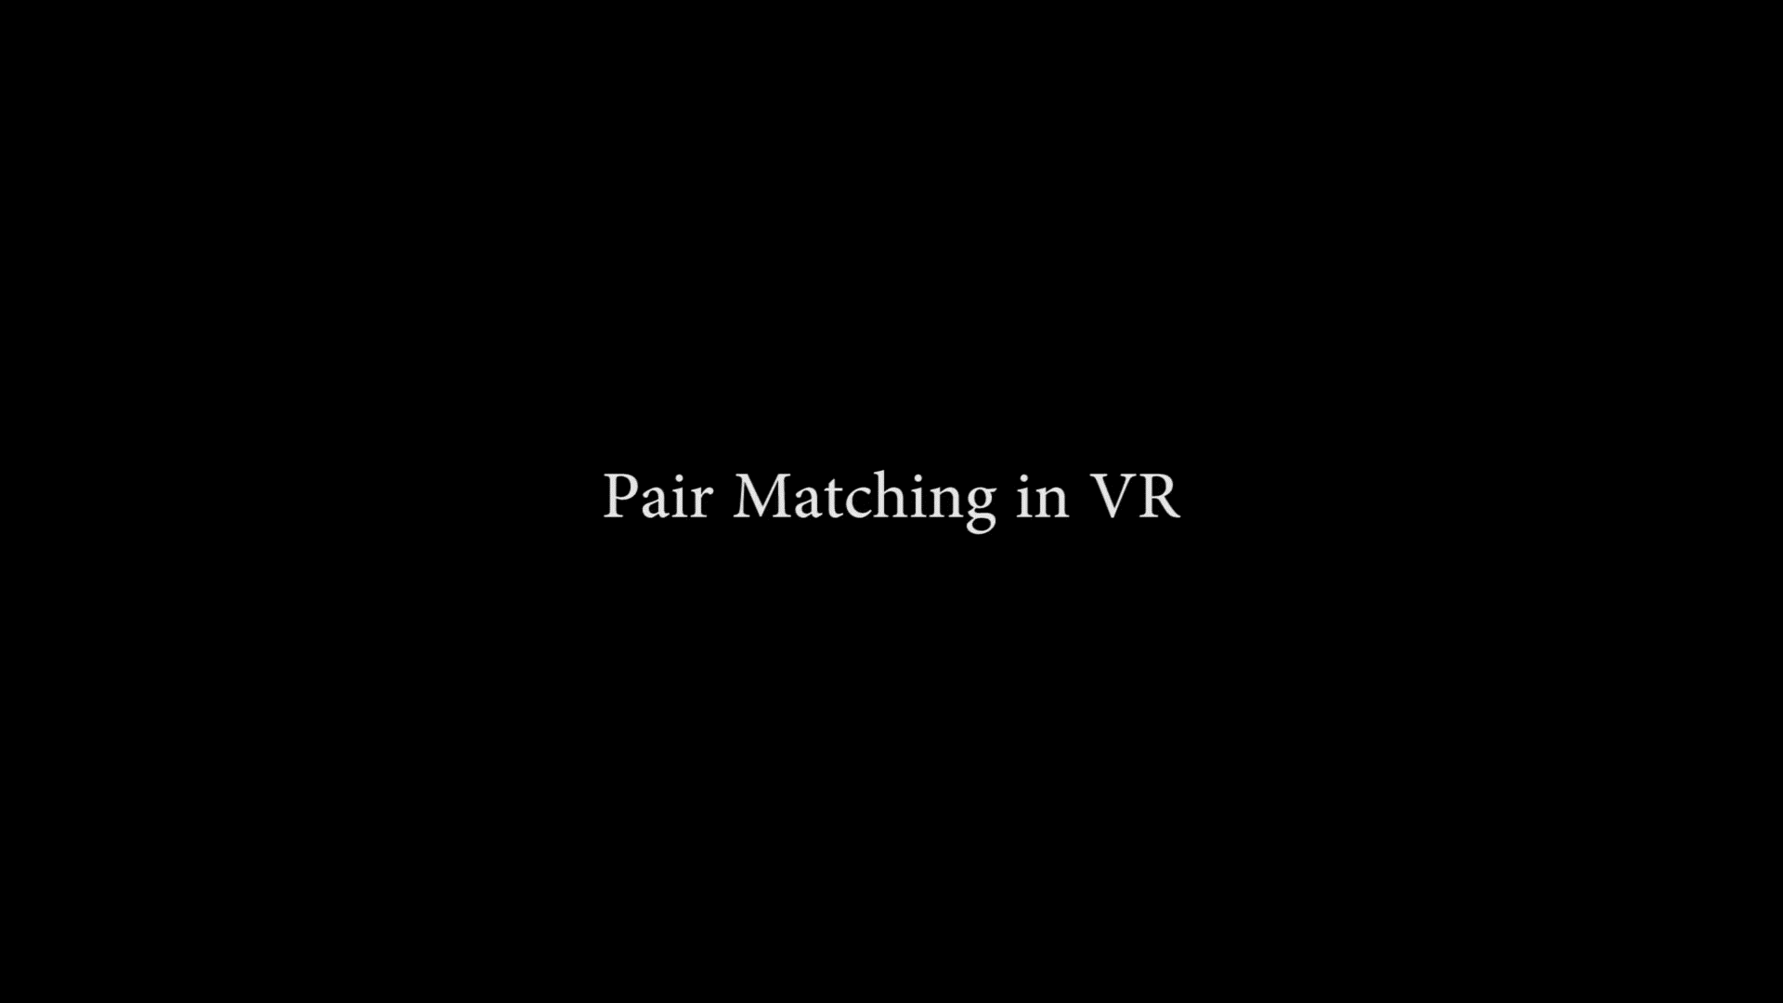
User study
VR task 2: pair matching

Slide 17
Sample user trajectory for VR matching
Conventional
MPV

Slide 18

User study
AR task 1: search

Slide 19

User study
AR task 2: ambushing evading target

Slide 20
User study results
Metrics
Total distance traveled
Total head rotation
Completion time
Significant improvement in all metrics, in all tasks*
* Except completion time in ambush task

Slide 21
MPV reduces distance traveled
Distance traveled, in meters
Task | Control | Experiment | Difference | p | d | Effect size
Tracking | 14 ± 3 | 5 ± 4 | 8 | < 0.01 | 2.3 | huge
Matching | 92 ± 47 | 8 ± 7 | 83 | < 0.01 | 2.5 | huge
Search | 99 ± 3 | 85 ± 12 | 14 | < 0.01 | 1.6 | very large
Ambush | 109 ± 17 | 93 ± 18 | 16 | 0.04 | 0.9 | large

Slide 22
MPV reduces head rotation
Head rotation, in hundreds of degrees
Task | Control | Experiment | Difference | p | d | Effect size
Tracking | 8 ± 1 | 4 ± 2 | 3 | < 0.01 | 1.8 | very large
Matching | 66 ± 23 | 10 ± 5 | 56 | < 0.01 | 3.4 | huge
Search | 42 ± 7 | 33 ± 11 | 9 | 0.04 | 1.0 | large
Ambush | 44 ± 9 | 34 ± 7 | 10 | 0.01 | 1.3 | very large

Slide 23
MPV reduces time
Completion time, in seconds
Task | Control | Experiment | Difference | p | d | Effect size
Tracking | n/a | n/a | n/a | n/a | n/a | n/a
Matching | 216 ± 86 | 58 ± 27 | 158 | < 0.01 | 2.5 | huge
Search | 92 ± 8 | 69 ± 20 | 23 | < 0.01 | 1.5 | very large
Ambush | 75 ± 25 | 74 ± 19 | 1.5 | 0.5 | 0.1 | very small

Slide 24
Conclusions and future work
MPV—nice superpower
Other applications, other MPV constructors?

Slide 25
Efficient VR and AR Navigation through Multiperspective Occlusion Management
Paper Session: 15
Meng-Lin Wu and Voicu Popescu
Purdue University
IEEE TVCG Invited Paper
Thank you!

